Slide 1
Human Rights
Unit 1

Slide 2
Human Rights
What are Human Rights?

Slide 3
Human Rights
Rights all people have just because they are human beings
Where are human rights limited to?
Nowhere, have them wherever we go.

Slide 4
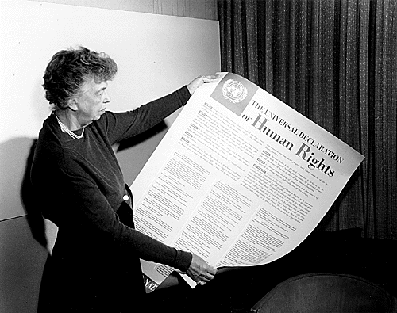
Universal Declaration of Human Rights
Statement of basic human rights and standards for government
Adopted by the UN in 1948 under the leadership of Eleanor Roosevelt

Slide 5
Background of the UDHR
Almost every country in the world has agreed on them.
Entitles everyone to liberty, education, political, and religious freedom, and economic well-being
Bans torture and says that all people have a right to participate in their government

Slide 6
UN’s role with Human Rights
UN has established a system of international treaties and other legal mechanisms to enforce human rights
International Covenant on Civil and Political Rights
International Covenant on Economic, Social, and Cultural Rights

Slide 7
Discuss
Some believe that the right to a clean environment should be added to the covenants…what are your thoughts?

Slide 8
What happens when…?
Here is the situation – The UDHR mentions cultural rights, and it is universally accepted that all people have a right to their own culture.
But what happens when culture comes into conflict with universally accepted human rights?
i.e. – female infanticide, or killing female babies
Should Culture trump individuals rights?

Slide 9
The Space Colony
You have been selected to join a group of space pioneers who will establish a colony on a distant planet. In order to create the best possible society, you and your group decide to make a list of the human rights that all space colonists should have.
List the three most important human rights that you believe should be guaranteed.
Compare your list with others. Explain reasons for your selections.
Why do you think some of the rights you listed are more important that others?
Do any of the rights you listed conflict with one another? If so, which ones and why?

Slide 10
Kinds of Laws
Two Major Categories
Criminal
Civil

Slide 11
Criminal Law
Purpose – regulate public conduct and set out duties owed to society
Legal action that can only be brought by the government against a person charged with committing a crime…why?
Severity of the Crime
Felonies – more serious crime, one or more years in prison
Misdemeanors – penalty is a prison term of one year or less, deals with less serious crimes

Slide 12
Civil Law
Regulates relations between individuals or groups of individuals
Civil Action – laws that can be brought by a person who feels wronged or injured by another person.
Courts typically award money

Slide 13
Burden of Proof
Criminal Trial
Beyond a reasonable doubt – jury or judge has any reasonable doubts about the defendants guilt, then it must vote not to convict
Civil Trial
Preponderance of the evidence – jury or judge needs only to decide if it is more likely than not that the plaintiff’s complaint is true

