Slide 1
Types of american Law
Goal 1

Slide 2
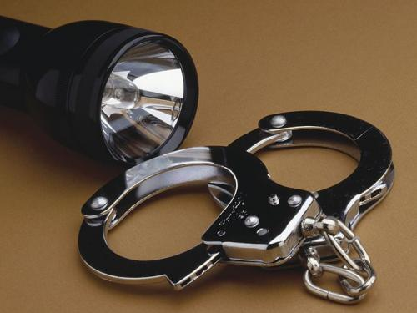
Types of Law
1. Criminal Law:
Prevent people from deliberately or recklessly harming others or other’s property.

Slide 3
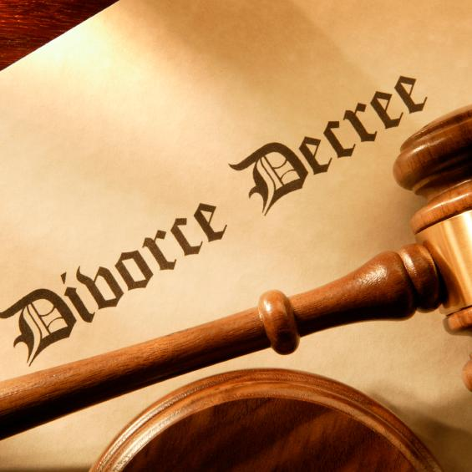
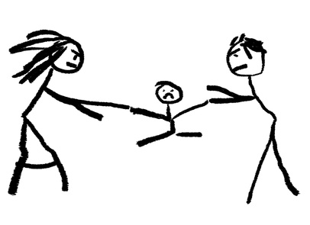
Types of Law
2. Civil Law:
Disputes between people or groups when no law has been broken.
Disputes get settled in a court case called a lawsuit.
- Tort: a civil case where injury occurs because of negligence.
-Family Law: Divorce, custody, child support, adoption.

Slide 4
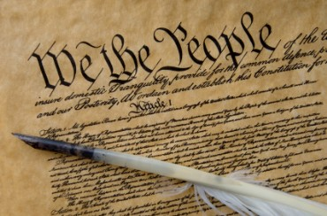
Types of Law
3. Public/Constitutional Law:
Rights of citizens and rules setting up how the government functions.
- Administrative Law: describes how executive agencies of the Federal government function.

Slide 5
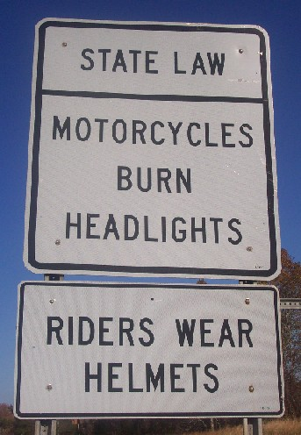
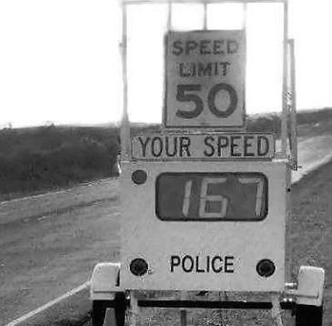
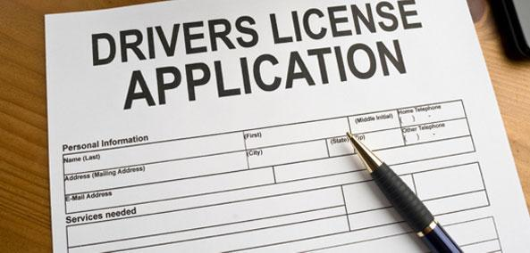
Types of Law
4. Statutory Law:
Laws for states. Ex: speed limits, alcohol laws, food inspection.

Slide 6
Types of Law
5. International Law:
Deal with geographic areas outside of a single country (oceans) and agreements between two or more countries.
- The World Court: settles disputes between two or more nations. Also prosecutes war criminals.

Slide 7
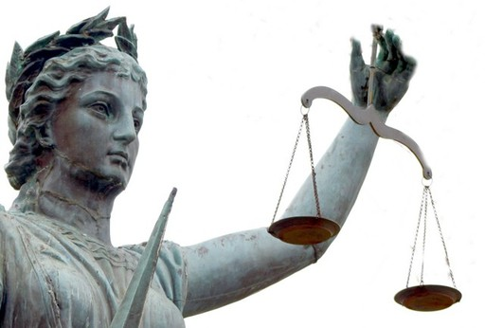
Criminal justice

Slide 8
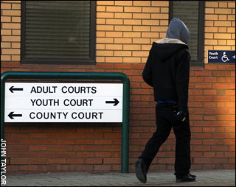
Criminal Cases
Defendants are charged with a crime- violation of the law
Defendant is the person accused of a crime
Government is the prosecution- party who starts the legal proceedings against another party for a violation of the law
Crimes are defined in each state’s written criminal laws called the penal code.
Juveniles or people under 18, have a separate justice system

Slide 9
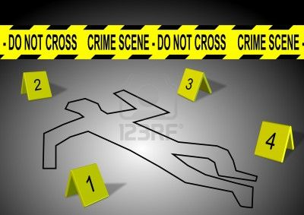
Types of Crimes
Misdemeanors- minor crimes that carry a sentence of 1 year or less
Felony- serious crimes that carry a sentence of 1 year or more in prison
~can lose rights (vote, own a gun) if convicted of a felony~
-Some misdemeanors can be treated as felonies(drunk driving)

Slide 10
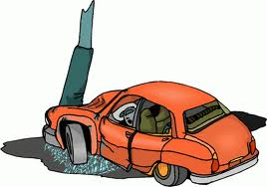
Crimes Against People “Acts committed against a person’s body”
Murder
1st Degree: Premeditated
2nd Degree: In the moment (anger)
- Manslaughter: Negligence caused death
two types:
voluntary-intent
involuntary-no intent

Slide 11
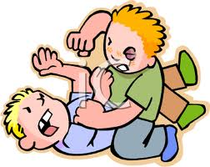
Crimes Against People “Acts committed against a person’s body”
Assault
Rape
Kidnapping

Slide 12
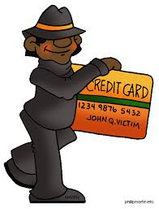
Crimes Against Property “Acts committed against a person’s items”
Larceny: theft
Burglary: breaking into a home or business
Robbery: forcibly taking items directly from a person
Vandalism: destruction of property
Arson: burning property
Fraud: misrepresentation of truth

Slide 13
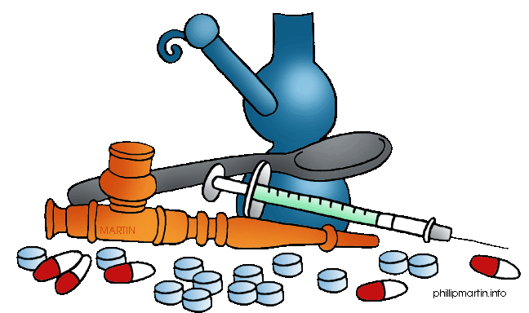
Victimless Crimes “Immoral acts, no victim except self”
Drugs
Gambling
Prostitution

Slide 14
Crime Statistics (2007)

Slide 16
Raleigh Crime Statistics
Year | Murder, Man-Slaughter | Forcible Rape | Robbery | Aggravated Assault
2001 | 10 | 91 | 804 | 1,282
2002 | 19 | 106 | 697 | 1,144
2003 | 14 | 81 | 748 | 1,161
2004 | 16 | 99 | 661 | 1,091
2005 | 20 | 88 | 762 | 1,181
2006 | 19 | 97 | 782 | 1325
2007 | 23 | 99 | 835 | 1141
2008 | 34 | 95 | 1025 | 1091
2009 | 14 | 99 | 832 | 1056

Slide 18
There were 27 homicides in Durham 2011, compared with 22 in 2010. Raleigh had 17 homicides in 2011, up three from the year before. In other areas across the state, the number of homicides in Charlotte dropped nearly 10 percent, to 55, while homicides in Greensboro more than doubled to 41.

