Slide 1

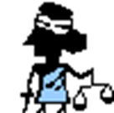


Introduction to Law
Goal 1

Slide 2
What is law?
Regulations established in a community by some authority and applies to its people
Could be written or custom
Recognized and enforced by judicial decision.

Slide 3


What is the purpose of law?
Protect public health
Provide safety, and “morals”
Advance the general welfare—including, protecting people's fundamental rights and basic liberties.
Protect basic Human Rights
How do we decide
what is “moral”?

Slide 4


Rule of Law
Principle that the law applies to everyone, even those who govern
Law applies!

Slide 5

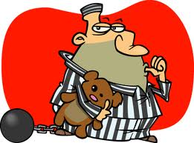
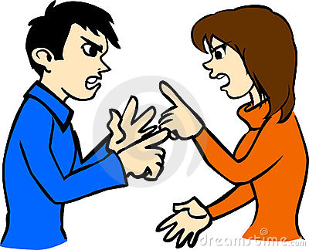
What should laws do?
Keep the peace
Prevent violent acts
Discourage potential or future criminals
Resolve disagreements over money, property, contracts and other noncriminal matters

Slide 6

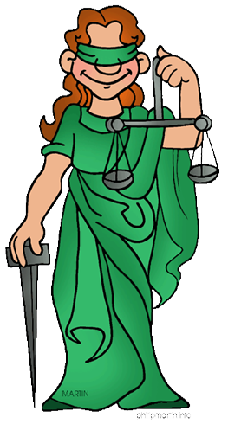
What makes a law a Good law?
Fair
Reasonable
Understandable
Enforceable

Slide 7
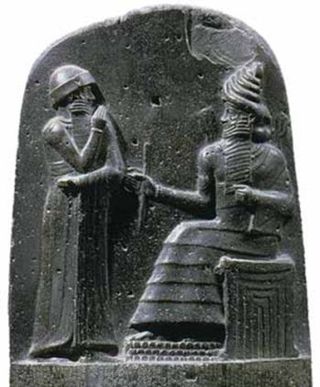
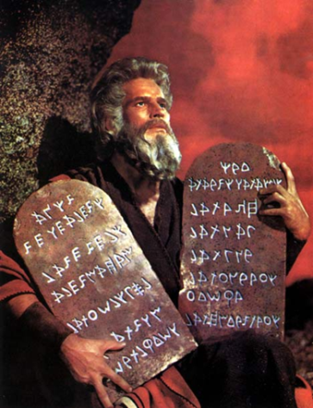
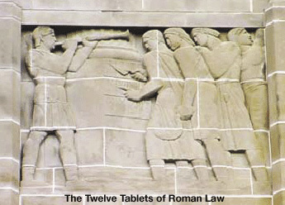
Sources of American Law
Code of Hammurabi- first known system of written
laws
Ten Commandments- Hebrew Bible “God’s laws”
Roman Law-Jurisprudence: the study of law. Roman judges studied and interpreted the laws of Rome
Ten Updated

Slide 8
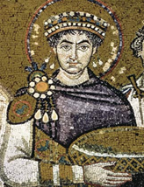

Sources of American Law
Justinian Code- Emperor Justinian of Eastern Roman Empire has all existing laws and decrees written down in a single document.
English Law-based on traditions and precedent. Not all laws written down.

Slide 9

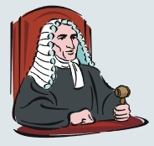
English Law
Established common law or law based on court decision
Precedent- judges look in books for a similar case and follow that earlier ruling
Magna Carta(1215)- established even the king must follow the law
Statute- law written by a legislative branch
Trial by jury
Innocent until proven guilty

Slide 10

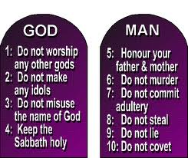

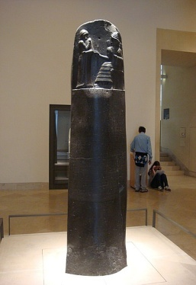
Development of Legal Systems
English
Common Law
Code of Hammurabi
Napoleonic
Code
Ten
Commandments
US
Constitution
Justinian Code
500BC
0
AD 500
1000
1500
2000
2000
1500
1000

Slide 11

Philosophical Influences
John Locke (1600s)- argued people were born
free, equal and independent and had natural rights
Natural Rights- right to life, liberty and property and NO GOVERNMENT could take that away

Slide 12

Philosophical Influences
Thomas Hobbes (1600s)- believed life would be chaos without government and law
Social contract- agreement among the people in a society
Give up some rights for protections

Slide 13

Questions…….To Turn In!
What are two laws you think are “good” laws? Why?
What are two laws you think are “bad” laws? Why?
Do you think religion should have any influence on law? Why/Why not?
Talk with your neighbor!

