Slide 1
Civilization Begins

Slide 2
Fertile Crescent
Ancient Fertile Crescent
Area between the Persian Gulf and the Mediterranean Sea
Tigris and Euphrates Rivers
Mesopotamia- the region that lies between the two rivers

Slide 3
Sumer
First civilization started here (present day Iraq)
people called Sumerians

Slide 4
City-States of Mesopotamia
Key Traits of a civilizations
Cities
Major difference between a city and a village is trade.
Citizens depended on trade to make money

Slide 5
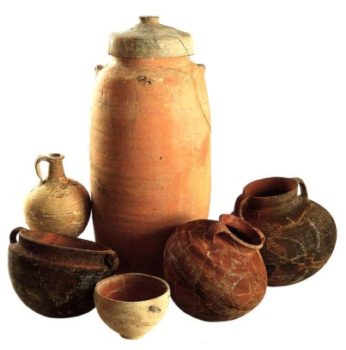
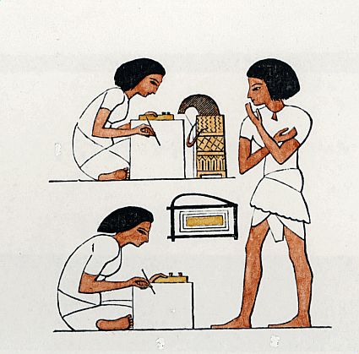
Key Traits of a civilizations
Specialized Workers
Each person was responsible for one job
Artisans: skilled workers who made goods by hand
Scribes, schoolmasters, merchants, priest, potters
Complex Institutions
Formal government with officials and laws
Organized religion (most cities had great temples which also served as the as the hub of all political activity)
The Sumerians were polytheist (belief in many gods)

Slide 6
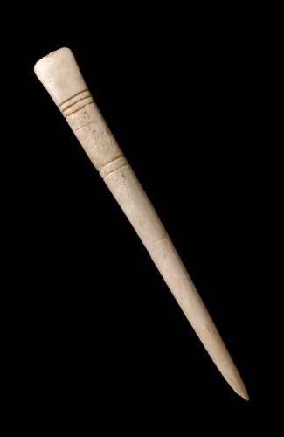
Record Keeping
Sumerian scribes invented a form of writing called cuneiform (wedge shaped writing)
Scribes used a stylus (sharpened reed with a wedge shaped point)

Slide 7
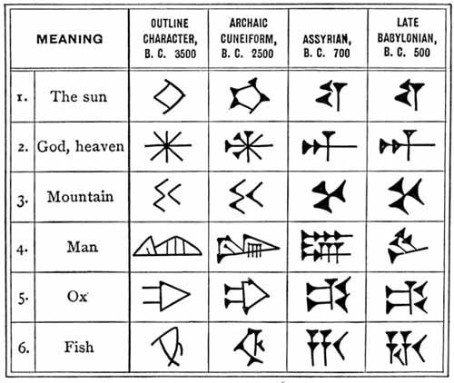
Cuneiform writing

Slide 8
Advanced Technology
The wheel, plow, and sailboat aided the Sumerians in their travel
Bronze weapons and body armor gave the Sumerians a military advantage over their enemies
Built ziggurat- pyramid-temple

Slide 9
Ziggurat

Slide 10
First sail boats

Slide 11
Creations of City-States
By 3000BC the Sumerians had built numerous cities that were surrounded by land called city-states
Earliest governments were controlled by the priest
Set up hierarchy or ranks in society
During times of war the priest was not in control, a commander was in charge
In time some military rulers became full time rulers who eventually passed their thrown down to their sons (a series of rulers from a single family is a dynasty)

Slide 12
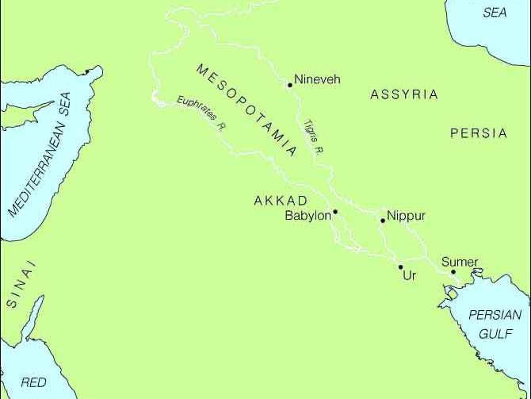
First Empire Builders
Sargon of Akkad
Sargon defeated the city-states of Sumer
Sargon, leader of the Akkadians created the first empire

Slide 13
Sargon-leader of the Amorites; first empire builder

Slide 14
Babylonian Empire
Nomadic warriors known as Amorites invaded Mesopotamia
It’s capital city was Babylon

Slide 15
Babylon

Slide 16
Hanging Gardens of Babylon
One of the 7 wonders of the world

Slide 17
Hammurabi
Leader of the Babylonians from 1792BC -1750BC
Wrote the first ever code of laws called Hammurabi’s Code
282 laws written on stones placed around the city
Code applied to everyone but not necessarily fair

Slide 18
Code of Hammurabi

Slide 19
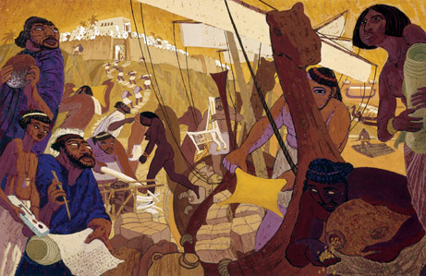
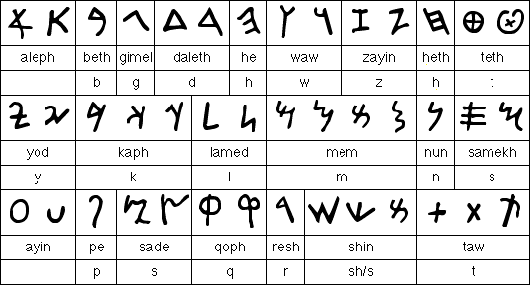
Other Great People of the time
Phoenicians
Trademark purple dye
Alphabet: needed a simple alphabet to ease the burden of record keeping

Slide 20
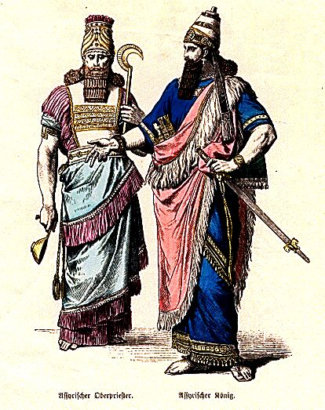
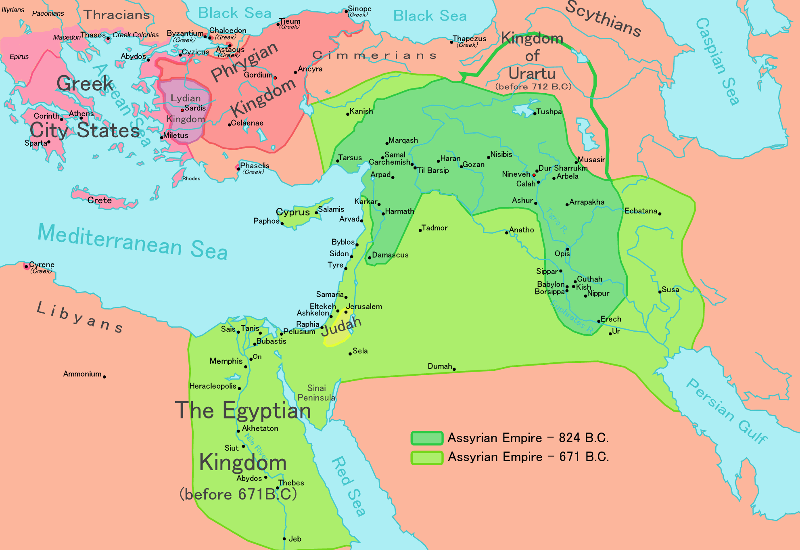
Assyrians
First to outfit an army
Terrorized their enemies
Built the world’s largest library

Slide 21
Assyrian weapons

Slide 22
Assyrian Empire

Slide 23
Assyrain chariot

Slide 24
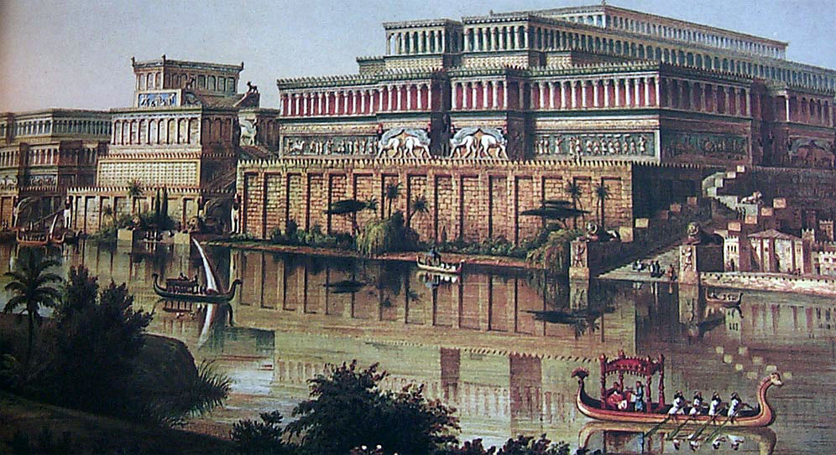
Assyrian library

Slide 25
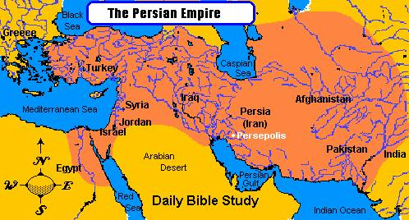
Persians
Divided the empire into satraps
Used coins for money

Slide 26
Persian coins

Slide 27
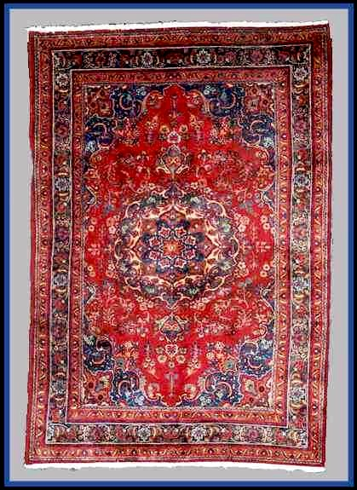
Persian Rugs
Cost around $1,500

Slide 28
